Slide 1
Correctness of Algorithm

Slide 2
Proof of Correctness of the algorithm:
Once an algorithm has been specified, you have to prove its correctness. That is, you have to prove that the algorithm yields a required result for every legitimate input in a finite amount of time.

Slide 3
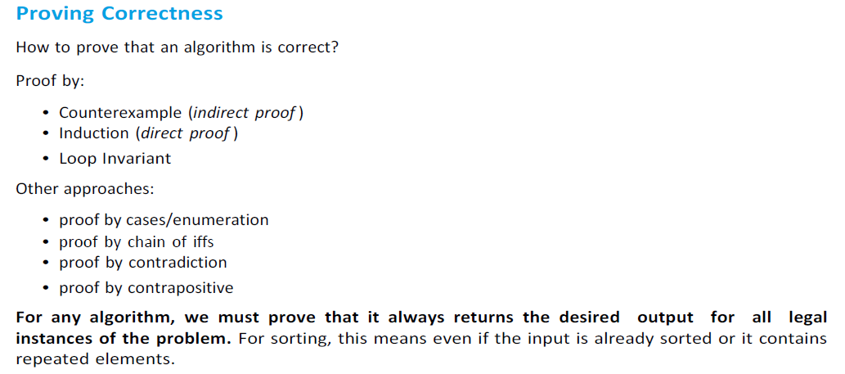
Proof Techniques

Slide 4
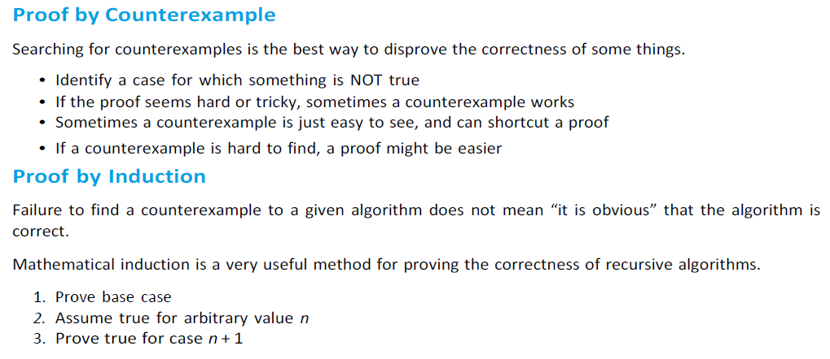

Slide 5
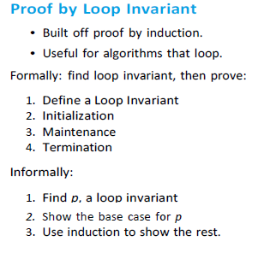

Slide 6
Example for checking correctness of an algorithm
Finding maximum from a list of elements
Checking correctness
a[]= {45,23,67,2}, n=4
Output : 67 (The algorithm works correctly for the given set of input)
int findMaximum(int a[],int n)
{
max=0;
for(i=1;i<=n;i++)
if (a[i]>max)
max=a[i];
return max
}
iteration | i | max | a[i]
0 |  | 0
1 | 1 | 45 | 45
2 | 2 | 45 | 23
3 | 3 | 67 | 67
4 | 4 | 67 | 2
a[]= { -17, -10, -4}, n=3
Output: 0 (The algorithm works incorrectly for the given set of input)
iteration | i | max | a[i]
0 |  | 0
1 | 1 | 0 | -17
2 | 2 | 0 | -10
3 | 3 | 0 | -4

Slide 7
Example for checking correctness of an algorithm- contd …
Checking correctness
So we initialize max as follows
a[]= { -17, -10, -4}, n=3
iteration | i | max | a[i]
0 |  | -17
1 | 1 | -10 | -10
2 | 2 | -4 | -4
int findMaximum(int a[],int n)
{
max=a[1];
for(i=2;i<=n;i++)
if (a[i]>max)
max=a[i];
return max
}
Output
-4
This algorithm works correctly for the given set of input

Slide 8
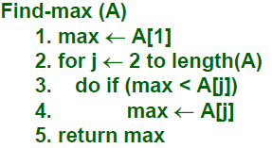
Algorithm Correctness Proof –By Contradiction
Prove that for any valid Input, the output of Find-max satisfies the output condition.
Proof by contradiction:
  Suppose the algorithm is incorrect for some input A,
    Case 1: max is not an element of A. max is initialized to and assigned to elements of A – which is impossible.
    Case 2: (∃ j | max < A[j]).
    After the j^{th} iteration of the for-loop (lines 2 – 4), max ≥ A[j]. From lines 3,4, max only increases.
  Therefore, upon termination, max ≥ A[j], which contradicts our assumption that max<A[j]

Slide 9
Loop invariance –Correctness proof
  Show the 3 things about a loop invariance:
  Initialization: It is true prior to the first iteration of the loop.
  Maintenance: If it is true before an iteration of the loop, it remains true before the next iteration.
  Termination: When the loop terminates, the invariant gives us a useful property that helps show that the algo is correct.

Slide 10
Loop invariance proof –Max algorithm…
Prove that for any valid Input, the output of Find-max satisfies the output condition.
Proof by loop invariants:
  Loop invariant: I(j): At the beginning of iteration j of the loop, max contains the maximum of A[1,..,j-1].
  Proof:
    True for j=2.
    Assume that the loop invariant holds for the j iteration, So at the beginning of iteration k, max = maximum of A[1,..,j-1].

Slide 11
Loop invariant proof for max algorithm…
Maintenance
  For the (j+1)^{th} iteration
    Case 1: A[j] is the maximum of A[1,…,j]. In lines 3, 4, max is set to A[j].
    Case 2: A[j] is not the maximum of A[1,…,j]. So the maximum of A[1,…, j] is in A[1,…,j-1]. By our assumption max already has this value and by lines 3-4 max is unchanged in this iteration.

Slide 12
Loop invariant proofs for Max algorithm…
Termination
STRATEGY: We proved that the invariant holds at the beginning of iteration j for each j used by Find-max.
  Upon termination, j = length(A)+1. (WHY?)
  The invariant holds, and so max contains the maximum of A[1..n]

Slide 13
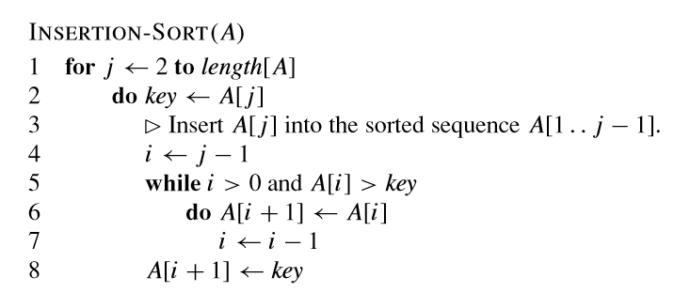

Correctness Proof for Insertion Sort
Pseudo code :

Slide 14
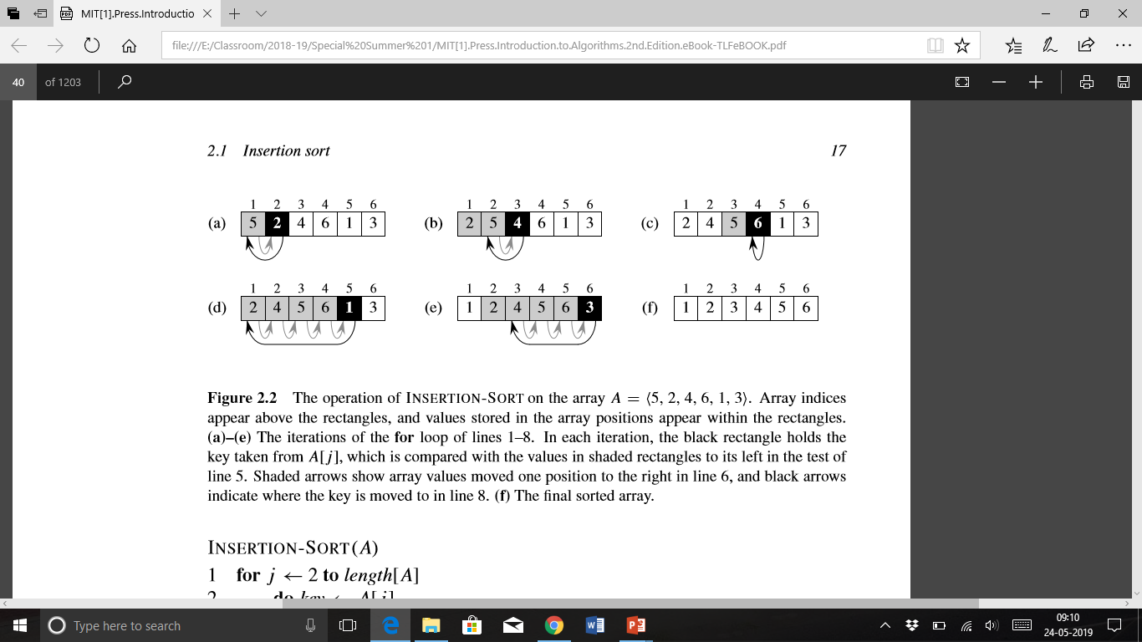
Insertion Sort Algorithm
Input: A sequence of n numbers {a1,a2,...,an}.
Output: A permutation (reordering) {a’1, a’2,...,a’n} of the input sequence such that a’1 ≤a’2 ≤···≤a’n.
The numbers that we wish to sort are also known as the keys.

Slide 15
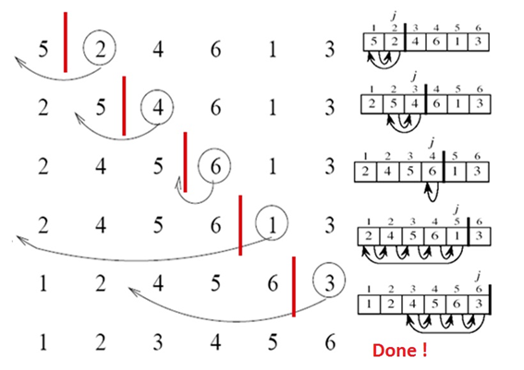

Slide 16
Proof of Correctness :
In order to prove the correctness of an algorithm, i.e. that it will work for any input set, we construct a loop invariant which is a condition that holds for each iteration of the loop (thus the name invariant). Then the proof consists of verifying that the algorithm maintains the loop invariant for three conditions:
1.Initialization - the loop invariant holds prior to the first iteration.
2.Maintenance - if the loop invariant is true prior to an iteration, then it is still true after the iteration.
3.Termination - the loop invariant is true when the loop terminates, i.e. after the last iteration thus producing the desired result
Note: This procedure is similar to an inductive proof with a base case and induction step but with added termination criteria.
The loop invariant for insertion sort can be stated as follows:
At each step, A[1..j-1] contains the first j-1 elements in SORTED order.

Slide 17
The proof of correctness is then straightforward:
Initialization: Prior to the loop j =2 ⇒ A[1.. j-1] = A[1] which contains only the A[1.. j-1] elements (of which there is only one) and since there is only a single element they are trivially sorted.
Maintenance: The outer for loop selects element A[ j] and positions it properly into A[1.. j-1] via the while loop. Since the array A[1.. j-1] began sorted, inserting element A[j] into the proper place produces A[1.. j] in sorted order (and contains the first j elements).
Termination: The loop terminates when j= n+1 ⇒ A[1.. j-1] = A[1.. ( n+1)-1] = A[1.. n] which since the array remains sorted after each iteration gives A[1.. n] is sorted when the loop terminates (and contains all the original elements) ⇒ the entire original array is sorted.

